Slide 1











PROJECT 3
CARSORE
GROUP 3

Slide 2


MEMBERS:
01
NGUYEN NHU VU
02
DO XUAN TRUONG
03
BACH NGOC ANH
04
NGUYEN THANH VAN
05
LE QUANG HUY
Mentor: VU HUU PHUONG

Slide 3








Current Issues: Manual vehicle insurance system is inefficient and error-prone.
Objectives: Automate processes, enhance data security, reduce paperwork, and support better decision-making.
INTRODUCTION
Outcome: Efficient, secure, and streamlined insurance operations.

Slide 4



TOOL AND TECHNOLOGY USED

Slide 5

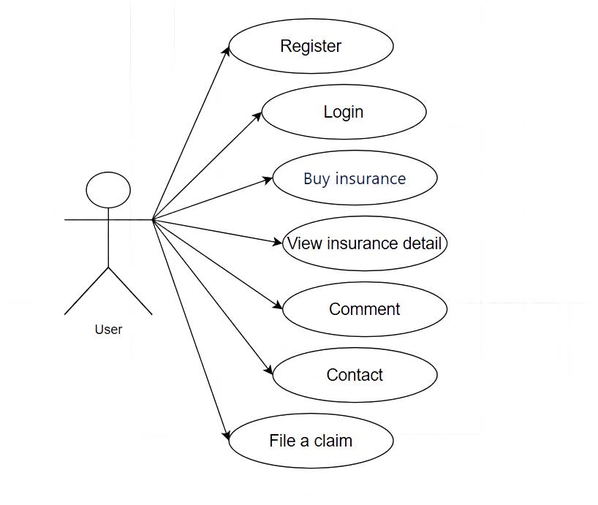


USER CASE BY USER

Slide 6
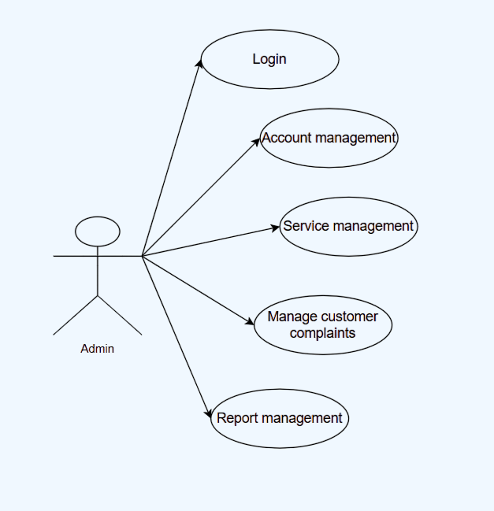
USE CASE BY ADMIN

Slide 7


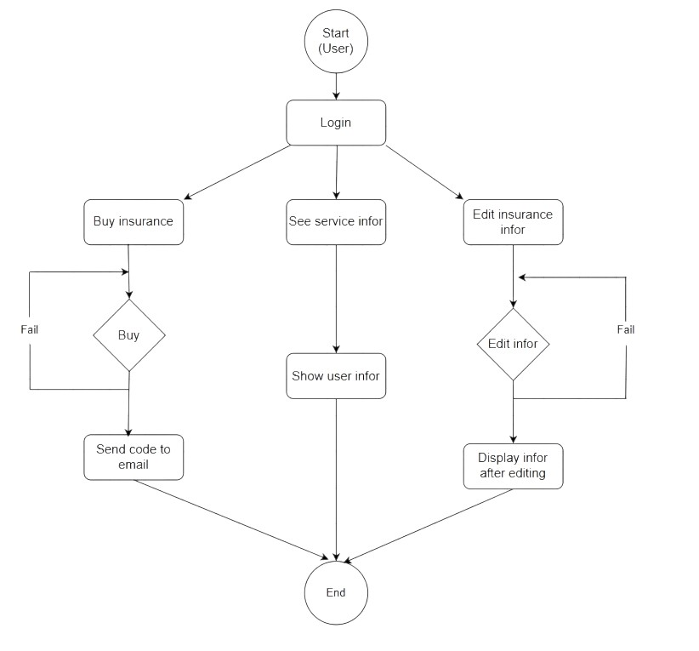
FOLOW CHART (USER)
Succes
Succes

Slide 8
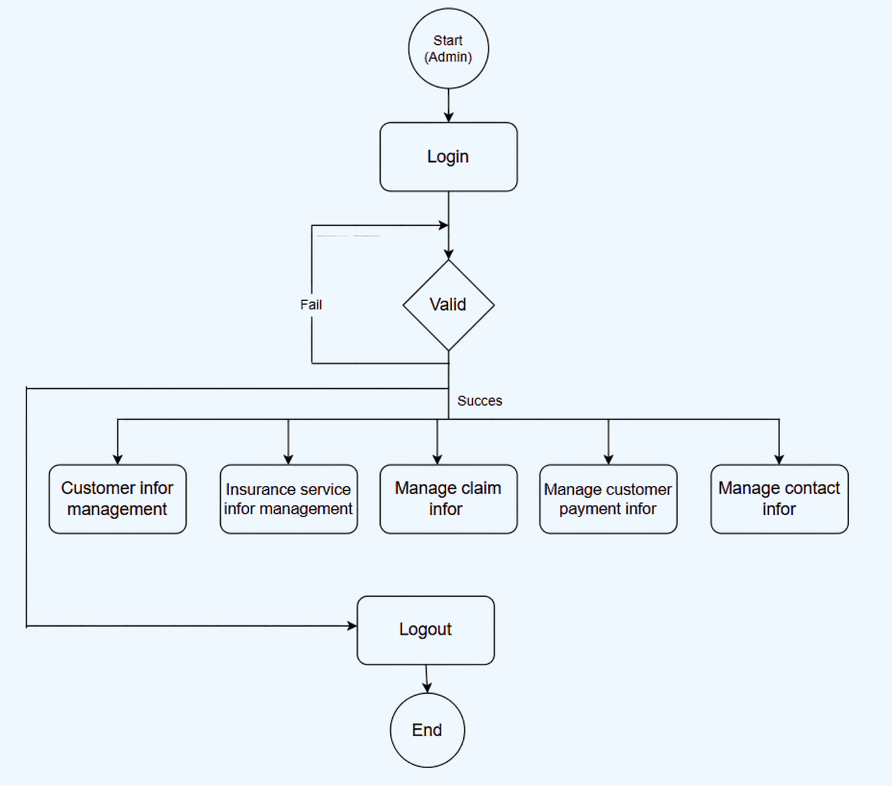
FOLOW CHART (ADMIN)

Slide 9

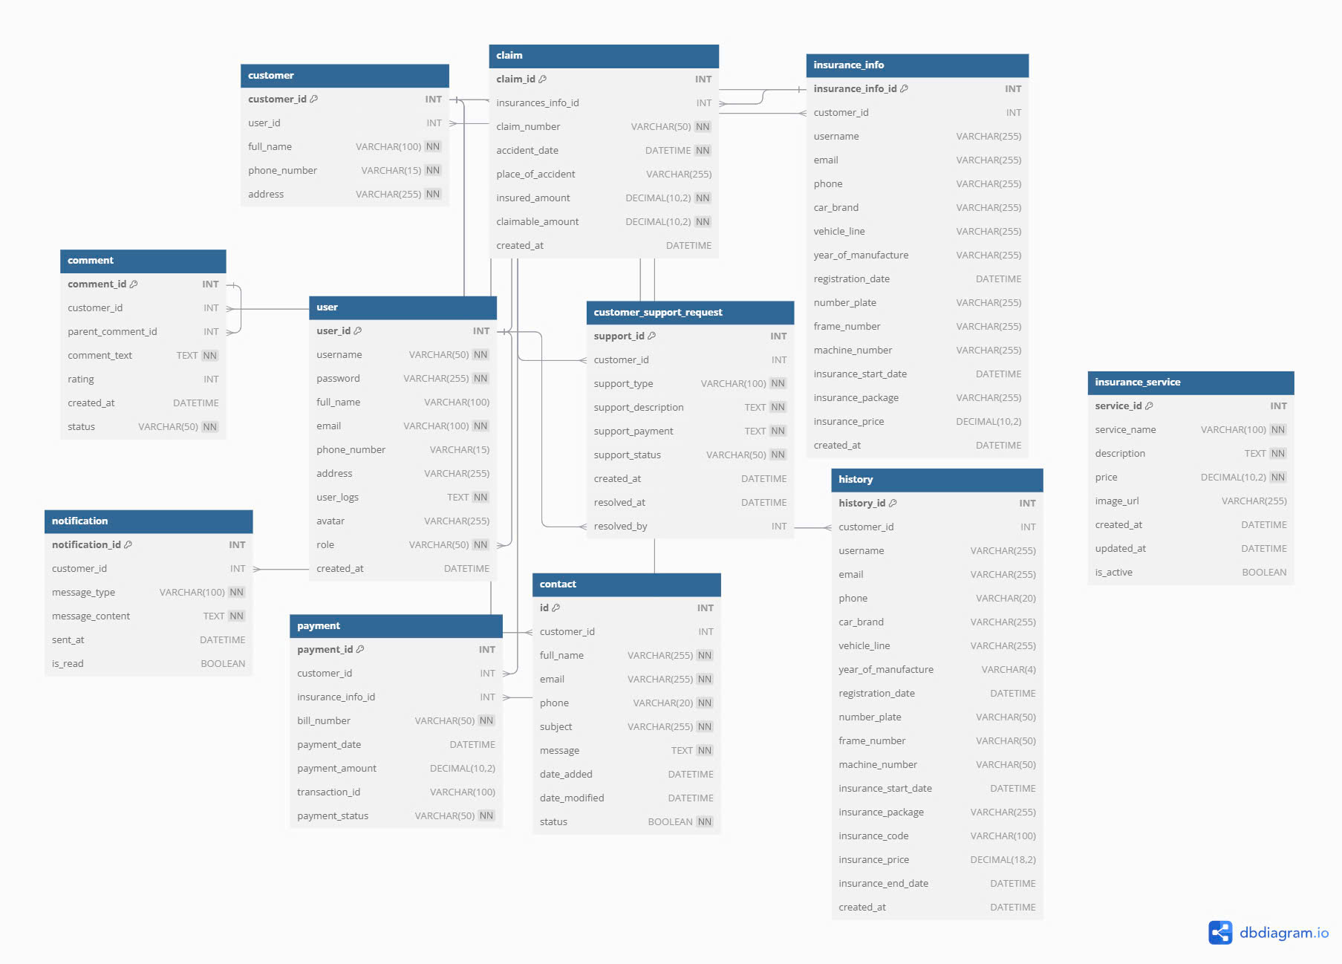
DATABASE DESIGN

Slide 10






THANK YOU

